Slide 1
Learning

Slide 2
References:
Stuart Russel, Peter Norvig: Artificial Intelligence - A Modern Approach, 2nd Edition, Pearson Education, 2012.
Elaine Rich, Kevin Knight, Shivashankar B Nair: Artificial Intelligence, 3rd Edition, Tata McGraw Hill, 2011.
Nils J. Nilsson: Principles of Artificial Intelligence, First Edition, Elsevier, 2002.
Luger, G. F., & Stubblefield, W. A., Artificial Intelligence - Structures and Strategies for Complex Problem Solving. New York, NY: Addison Wesley, 5th edition (2005).
Acknowledgement:
All the recourses materials available on the Internet in the area of
Artificial Intelligence

Slide 3
Learning
Motivation
Objectives
Learning from Observation
  Learning Agents
  Inductive Learning
  Learning Decision Trees
Computational Learning Theory
  Probably Approximately Correct (PAC) Learning

Slide 4
Bridge-In
“knowledge infusion” is not always the best way of providing an agent with knowledge
  impractical,tedious
  incomplete, imprecise, possibly incorrect
adaptivity
  an agent can expand and modify its knowledge base to reflect changes
improved performance
  through learning the agent can make better decisions
autonomy
  without learning, an agent can hardly be considered autonomous

Slide 5
Motivation
learning is important for agents to deal with
  unknown environments
  changes
the capability to learn is essential for the autonomy of an agent
in many cases, it is more efficient to train an agent via examples, than to “manually” extract knowledge from the examples, and “instill” it into the agent
agents capable of learning can improve their performance

Slide 6
Objectives
be aware of the necessity of learning for autonomous agents
understand the basic principles and limitations of inductive learning from examples
apply decision tree learning to deterministic problems characterized by Boolean functions
understand the basic learning methods of perceptrons and multi-layer neural networks
know the main advantages and problems of learning in neural networks

Slide 7
Learning
an agent tries to improve its behavior through observation
  learning from experience
    memorization of past percepts, states, and actions
    generalizations, identification of similar experiences
  forecasting
    prediction of changes in the environment
  theories
    generation of complex models based on observations and reasoning

Slide 8
Forms of Learning
supervised learning
  an agent tries to find a function that matches examples from a sample set
    each example provides an input together with the correct output
  a teacher provides feedback on the outcome
    the teacher can be an outside entity, or part of the environment
unsupervised learning
  the agent tries to learn from patterns without corresponding output values

Slide 9
Forms of Learning cont
reinforcement learning
  the agent does not know the exact output for an input, but it receives feedback on the desirability of its behavior
    the feedback can come from an outside entity, the environment, or the agent itself
    the feedback may be delayed, and not follow the respective action immediately

Slide 10
Learning from Observation
Learning Agents
Inductive Learning
Learning Decision Trees

Slide 11
Learning Agents
based on previous agent designs, such as reflexive, model-based, goal-based agents
  those aspects of agents are encapsulated into the performance element of a learning agent
a learning agent has an additional learning element
  usually used in combination with a critic and a problem generator for better learning
most agents learn from examples
  inductive learning

Slide 12
Learning Agent Model
Performance
Standard
Sensors
Critic
Feedback
Changes
Performance Element
Learning Element
Knowledge
Learning
Goals
Problem Generator
Agent
Effectors
Environment

Slide 13
Components Learning Agent
learning element
performance element
critic
problem generator

Slide 14
Learning Element
responsible for making improvements
uses knowledge about the agent and feedback on its actions to improve performance

Slide 15
Performance Element
selects external actions
collects percepts, decides on actions
incorporated most aspects of our previous agent design

Slide 16
Critic
informs the learning element about the performance of the action
must use a fixed standard of performance
  should be from the outside
  an internal standard could be modified to improve performance
    sometimes used by humans to justify or disguise low performance

Slide 17
Problem Generator
suggests actions that might lead to new experiences
may lead to some sub-optimal decisions in the short run
  in the long run, hopefully better actions may be discovered
otherwise no exploration would occur

Slide 18
Learning Element Design Issues
selections of the components of the performance elements that are to be improved
representation mechanisms used in those components
availability of feedback
availability of prior information

Slide 19
Performance Element Components
multitude of different designs of the performance element
  corresponding to the various agent types discussed earlier
candidate components for learning
  mapping from conditions to actions
  methods of inferring world properties from percept sequences
  changes in the world
  exploration of possible actions
  utility information about the desirability of world states
  goals to achieve high utility values

Slide 20
Component Representation
many possible representation schemes
  weighted polynomials (e.g. in utility functions for games)
  propositional logic
  predicate logic
  probabilistic methods (e.g. belief networks)
learning methods have been explored and developed for many representation schemes

Slide 21
Feedback
provides information about the actual outcome of actions
supervised learning
  both the input and the output of a component can be perceived by the agent directly
  the output may be provided by a teacher
reinforcement learning
  feedback concerning the desirability of the agent’s behavior is available
    not in the form of the correct output
  may not be directly attributable to a particular action
    feedback may occur only after a sequence of actions
  the agent or component knows that it did something right (or wrong), but not what action caused it

Slide 22
Prior Knowledge
background knowledge available before a task is tackled
can increase performance or decrease learning time considerably
many learning schemes assume that no prior knowledge is available
in reality, some prior knowledge is almost always available
  but often in a form that is not immediately usable by the agent

Slide 23
Inductive Learning
tries to find a function h (the hypothesis) that approximates a set of samples defining a function f
  the samples are usually provided as
  input-output pairs (x, f(x))
supervised learning method
relies on inductive inference, or induction
  conclusions are drawn from specific instances to more general statements

Slide 24
Hypotheses
finding a suitable hypothesis can be difficult
  since the function f is unknown, it is hard to tell if the hypothesis h is a good approximation
the hypothesis space describes the set of hypotheses under consideration
  e.g. polynomials, sinusoidal functions, propositional logic, predicate logic, ...

Slide 25
Hypotheses cont
  the choice of the hypothesis space can strongly influence the task of finding a suitable function
  while a very general hypothesis space (e.g. Turing machines) may be guaranteed to contain a suitable function, it can be difficult to find it
Ockham’s razor: if multiple hypotheses are consistent with the data, choose the simplest one

Slide 26
Example Inductive Learning 1
f(x)
input-output pairs displayed as points in a plane
the task is to find a hypothesis (functions) that connects the points
  either all of them, or most of them
various performance measures
  number of points connected
  minimal surface
  lowest tension
x

Slide 27
Example Inductive Learning 2
f(x)
hypothesis is a function consisting of linear segments
fully incorporates all sample pairs
  goes through all points
very easy to calculate
has discontinuities at the joints of the segments
moderate predictive performance
x

Slide 28
Example Inductive Learning 3
f(x)
hypothesis expressed as a polynomial function
incorporates all samples
more complicated to calculate than linear segments
no discontinuities
better predictive power
x

Slide 29
Example Inductive Learning 4
f(x)
hypothesis is a linear functions
does not incorporate all samples
extremely easy to compute
low predictive power
x

Slide 30
Learning and Decision Trees
based on a set of attributes as input, predicted output value, the decision is learned
  it is called classification learning for discrete values
  regression for continuous values
Boolean or binary classification
  output values are true or false
  conceptually the simplest case, but still quite powerful
making decisions
  a sequence of test is performed, testing the value of one of the attributes in each step
  when a leaf node is reached, its value is returned
  good correspondence to human decision-making

Slide 31
Boolean Decision Trees
compute yes/no decisions based on sets of desirable or undesirable properties of an object or a situation
  each node in the tree reflects one yes/no decision based on a test of the value of one property of the object
    the root node is the starting point
    leaf nodes represent the possible final decisions
  branches are labeled with possible values
the learning aspect is to predict the value of a goal predicate (also called goal concept)
  a hypothesis is formulated as a function that defines the goal predicate

Slide 32
Terminology
example or sample
  describes the values of the attributes and that of the goal predicated
    a positive sample has the value true for the goal predicate, a negative sample false
  the training set consists of samples used for constructing the decision tree
  the test set is used to determine if the decision tree performs correctly
    ideally, the test set is different from the training set

Slide 33
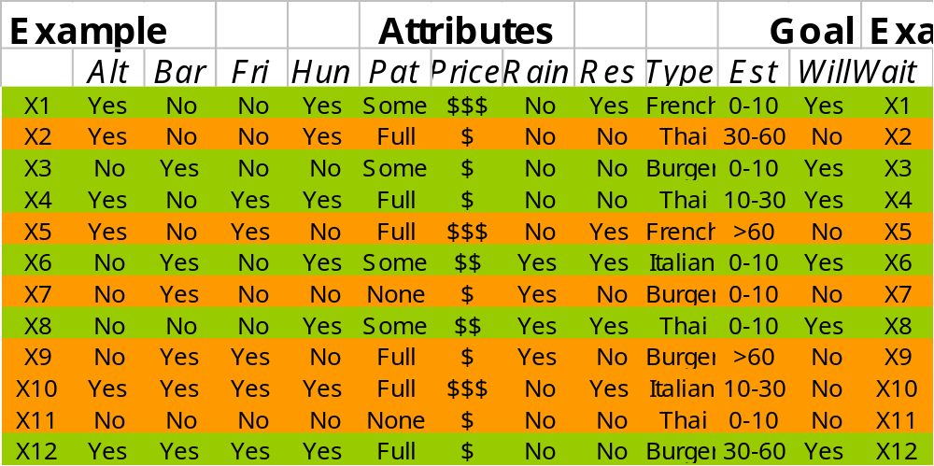
Restaurant Sample Set

Slide 34
Decision Tree Example
Patrons?
None
Some
Full
No
Yes
EstWait?
0-10
30-60
> 60
10-30
Yes
Hungry?
Alternative?
No
No
Yes
No
Yes
Yes
Alternative?
No
Reservation?
No
Yes
No
Yes
Yes
Raining?
Yes
Bar?
Yes
No
Yes
No
Yes
No
Yes
No
To wait, or not to wait for a table?

Slide 35
Decision Tree Exercise
Formulate a decision tree for the following question:
Should I take the opportunity to eliminate a low score in an assignment by doing an extra task?
  some possible criteria
    need for improvement
    amount of work required
    deadline
    other obligations

Slide 36
Expressiveness of Decision Trees
decision trees can also be expressed as implication sentences
in principle, they can express propositional logic sentences
  each row in the truth table of a sentence can be represented as a path in the tree
  often there are more efficient trees
some functions require exponentially large decision trees
  parity function, majority function

Slide 37
Learning Decision Trees
problem: find a decision tree that agrees with the training set
trivial solution: construct a tree with one branch for each sample of the training set
  works perfectly for the samples in the training set
  may not work well for new samples (generalization)
  results in relatively large trees
better solution: find a concise tree that still agrees with all samples
  corresponds to the simplest hypothesis that is consistent with the training set

Slide 38
Ockham’s Razor
The most likely hypothesis is the simplest one that is consistent with all observations.
  general principle for inductive learning
  a simple hypothesis that is consistent with all observations is more likely to be correct than a complex one

Slide 39
Constructing Decision Trees
in general, constructing the smallest possible decision tree is an intractable problem
algorithms exist for constructing reasonably small trees
basic idea: test the most important attribute first
  attribute that makes the most difference for the classification of an example
    can be determined through information theory
  hopefully will yield the correct classification with few tests

Slide 40
Decision Tree Algorithm
recursive formulation
  select the best attribute to split positive and negative examples
  if only positive or only negative examples are left, we are done
  if no examples are left, no such examples were observers
    return a default value calculated from the majority classification at the node’s parent
  if we have positive and negative examples left, but no attributes to split them we are in trouble
    samples have the same description, but different classifications
    may be caused by incorrect data (noise), or by a lack of information, or by a truly non-deterministic domain

Slide 41
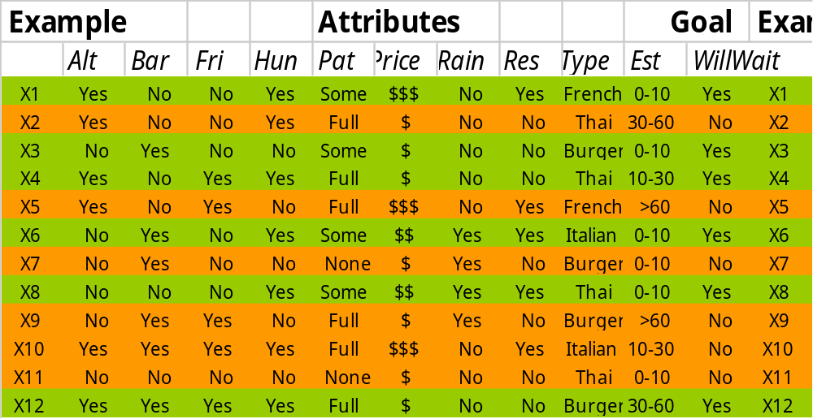
Restaurant Sample Set

Slide 42
Restaurant Sample Set
select best attribute
  candidate 1: Pat Some and None in agreement with goal
  candidate 2: Type No values in agreement with goal

Slide 43
Partial Decision Tree
Patrons needs further discrimination only for the Full value
None and Some agree with the WillWait goal predicate
the next step will be performed on the remaining samples for the Full value of Patrons
X1, X3, X4, X6, X8, X12
X2, X5, X7, X9, X10, X11
Patrons?
None
Full
Some
X7, X11
X1, X3, X6, X8
X4, X12
X2, X5, X9, X10
No
Yes

Slide 44
Restaurant Sample Set
select next best attribute
  candidate 1: Hungry No in agreement with goal
  candidate 2: Type No values in agreement with goal

Slide 45
Partial Decision Tree
Hungry needs further discrimination only for the Yes value
No agrees with the WillWait goal predicate
the next step will be performed on the remaining samples for the Yes value of Hungry
X1, X3, X4, X6, X8, X12
X2, X5, X7, X9, X10, X11
Patrons?
None
Full
Some
X7, X11
X1, X3, X6, X8
X4, X12
X2, X5, X9, X10
No
Yes
Hungry?
Y
N
X4, X12
X5, X9
X2, X10
No

Slide 46
Restaurant Sample Set
select next best attribute
  candidate 1: Type Italian, Burger in agreement with goal
  candidate 2: Friday No in agreement with goal

Slide 47
Partial Decision Tree
X1, X3, X4, X6, X8, X12
X2, X5, X7, X9, X10, X11
Hungry needs further discrimination only for the Yes value
No agrees with the WillWait goal predicate
the next step will be performed on the remaining samples for the Yes value of Hungry
Patrons?
None
Full
Some
X7, X11
X1, X3, X6, X8
X4, X12
X2, X5, X9, X10
No
Yes
Hungry?
Y
N
X4, X12
X5, X9
X2, X10
Type?
No
French
Thai
Burger
Ital.
Yes
X10
X4
X12
No
X2
Yes

Slide 48
Restaurant Sample Set
select next best attribute
  candidate 1: Friday Yes and No in agreement with goal

Slide 49
Decision Tree
X1, X3, X4, X6, X8, X12
X2, X5, X7, X9, X10, X11
Patrons?
None
Some
Full
the two remaining samples can be made consistent by selecting Friday as the next predicate
no more samples left
X7, X11
X1, X3, X6, X8
X4, X12
X2, X5, X9, X10
Yes
No
Hungry?
Y
N
X4, X12
X5, X9
X2, X10
Type?
No
French
Ital.
Burger
Thai
Yes
X10
X4
X12
No
X2
Yes
Friday?
Y
N
X4
X2
Yes
No

Slide 50
Performance of Decision Tree Learning
quality of predictions
  predictions for the classification of unknown examples that agree with the correct result are obviously better
  can be measured easily after the fact
  it can be assessed in advance by splitting the available examples into a training set and a test set
    learn the training set, and assess the performance via the test set
size of the tree
  a smaller tree (especially depth-wise) is a more concise representation

Slide 51
Noise and Overfitting
the presence of irrelevant attributes (“noise”) may lead to more degrees of freedom in the decision tree
  the hypothesis space is unnecessarily large
overfitting makes use of irrelevant attributes to distinguish between samples that have no meaningful differences
  e.g. using the day of the week when rolling dice
  overfitting is a general problem for all learning algorithms
decision tree pruning identifies attributes that are likely to be irrelevant
  very low information gain
cross-validation splits the sample data in different training and test sets
  results are averaged

Slide 52
Ensemble Learning
multiple hypotheses (an ensemble) are generated, and their predictions combined
  by using multiple hypotheses, the likelihood for misclassification is hopefully lower
  also enlarges the hypothesis space
boosting is a frequently used ensemble method
  each example in the training set has a weight associated
  the weights of incorrectly classified examples are increased, and a new hypothesis is generated from this new weighted training set
  the final hypothesis is a weighted-majority combination of all the generated hypotheses

Slide 53
Computational Learning Theory
relies on methods and techniques from theoretical computer science, statistics, and AI
used for the formal analysis of learning algorithms
basic principles
  if a hypothesis is seriously wrong, it will most likely generate a false prediction even for small numbers of examples
  if a hypothesis is consistent with a reasonably large number of examples, one can assume that most likely it is quite good, or probably approximately correct

